Slide 1
Improving structure with inheritance
7.0

Slide 2
Main concepts to be covered
Inheritance
Subtyping
Substitution
Polymorphic variables

Slide 3
The Network example
A small, prototype social network.
Supports a news feed with posts.
Stores text posts and photo posts.
MessagePost: multi-line text message.
PhotoPost: photo and caption.
Allows operations on the posts:
E.g., search, display and remove.

Slide 4
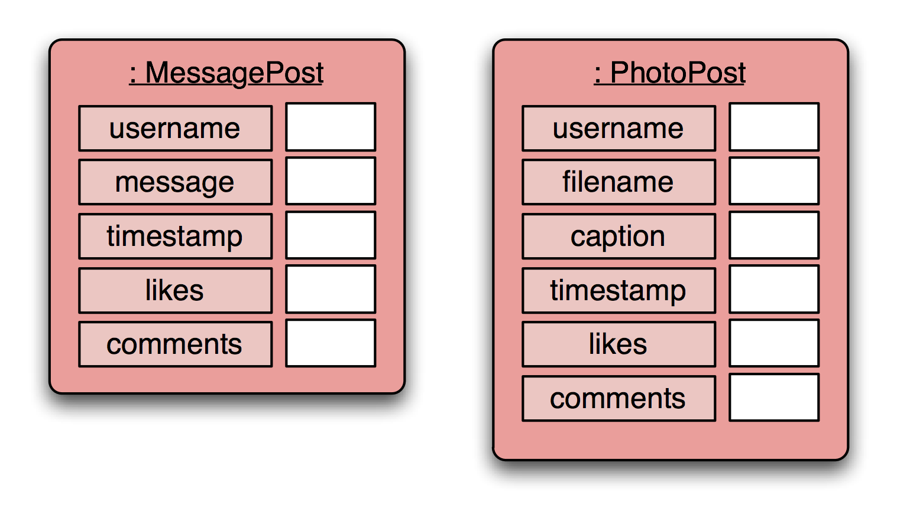
Network objects

Slide 5
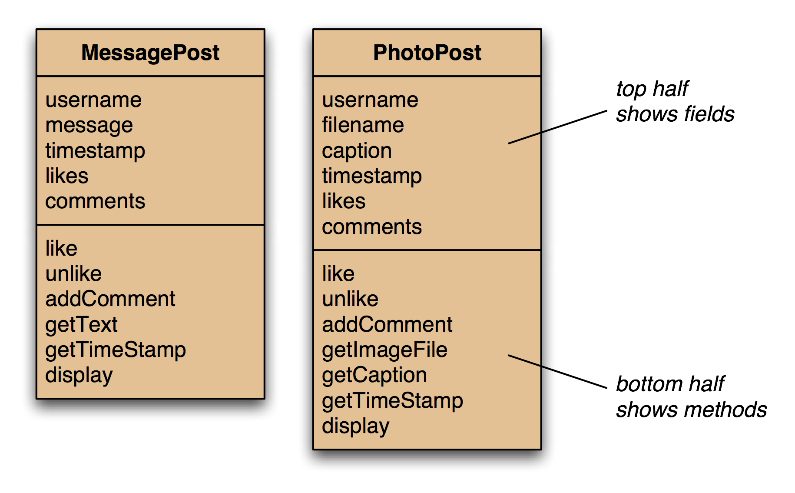
Network classes

Slide 6
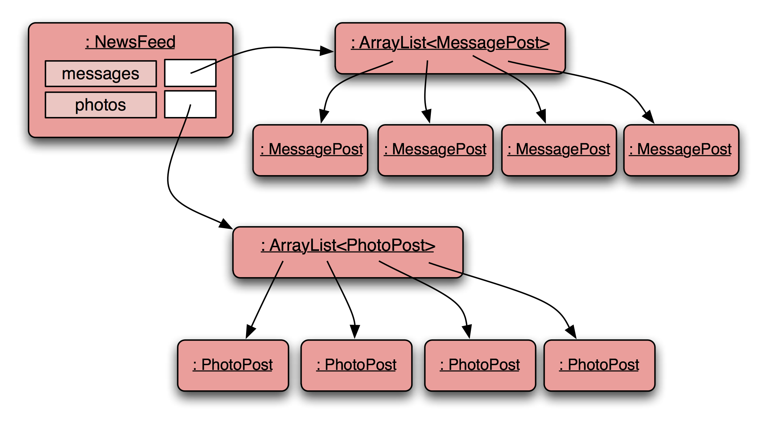
Network object model

Slide 7
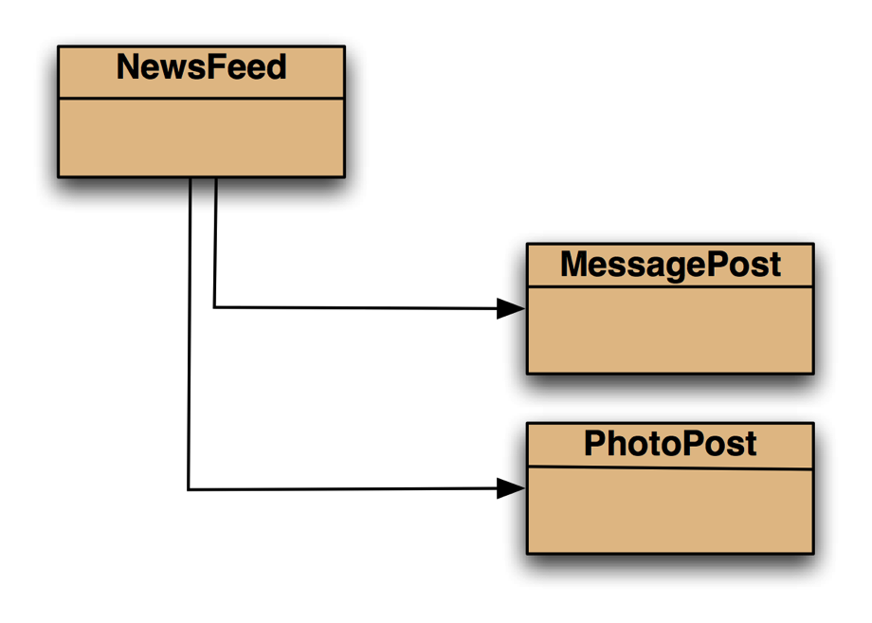
Class diagram

Slide 8
MessagePost source code Just an outline
public class MessagePost
{
private String username;
private String message;
private long timestamp;
private int likes;
private ArrayList<String> comments;
public MessagePost(String author, String text)
{
username = author;
message = text;
timestamp = System.currentTimeMillis();
likes = 0;
comments = new ArrayList<>();
}
public void addComment(String text) ...
public void like() ...
public void display() ...
...
}

Slide 9
PhotoPost source code Just an outline
public class PhotoPost
{
private String username;
private String filename;
private String caption;
private long timestamp;
private int likes;
private ArrayList<String> comments;
public PhotoPost(String author, String filename,
String caption)
{
username = author;
this.filename = filename;
this.caption = caption;
timestamp = System.currentTimeMillis();
likes = 0;
comments = new ArrayList<>();
}
public void addComment(String text) ...
public void like() …
public void display() …
...
}

Slide 10
public class NewsFeed
{
private ArrayList<MessagePost> messages;
private ArrayList<PhotoPost> photos;
...
public void show()
{
for(MessagePost message : messages) {
message.display();
System.out.println(); // empty line between posts
}
for(PhotoPost photo : photos) {
photo.display();
System.out.println(); // empty line between posts
}
}
}
NewsFeed

Slide 11
Critique of Network
Code duplication:
MessagePost and PhotoPost classes very similar (large parts are identical)
makes maintenance difficult/more work
introduces danger of bugs through incorrect maintenance
Code duplication in NewsFeed class as well.

Slide 12
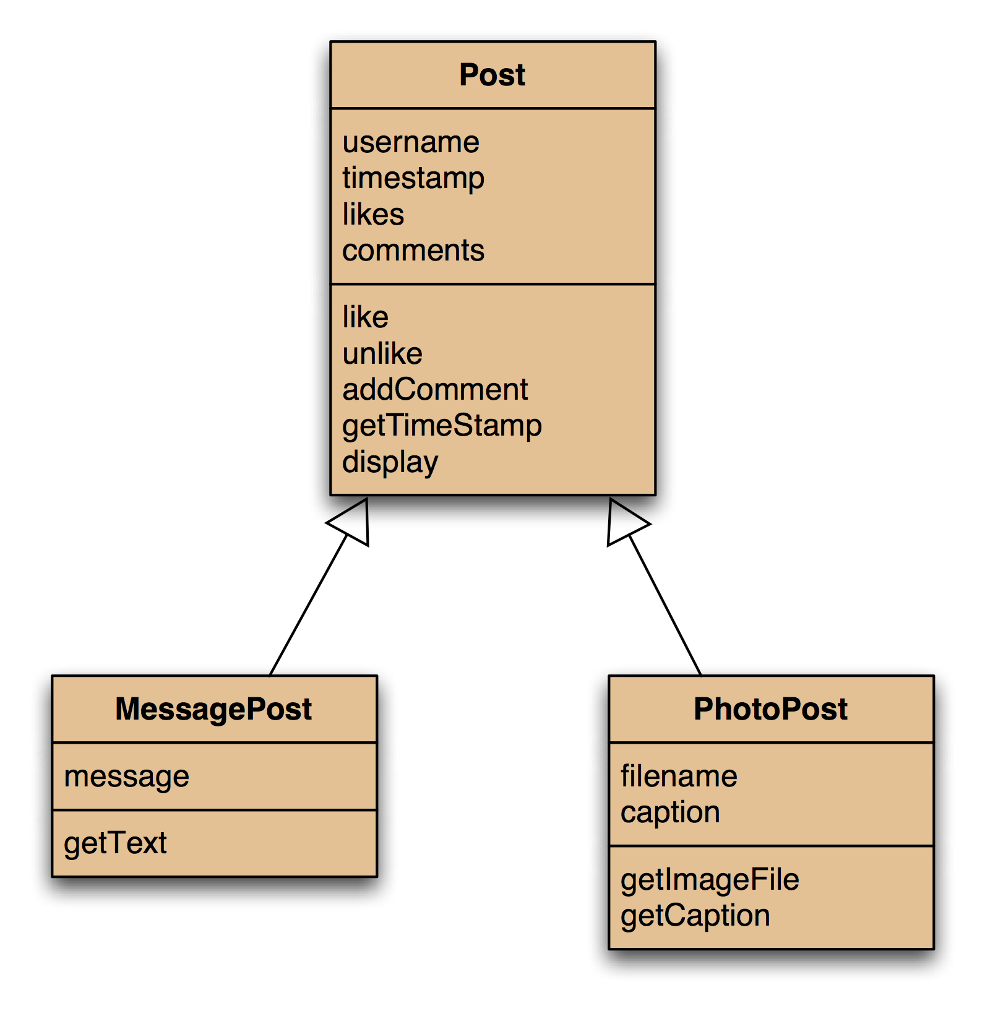
Using inheritance

Slide 13
Using inheritance
define one superclass : Post
define subclasses for MessagePost and PhotoPost
the superclass defines common attributes (via fields)
the subclasses inherit the superclass characteristics
the subclasses add other characteristics

Slide 14
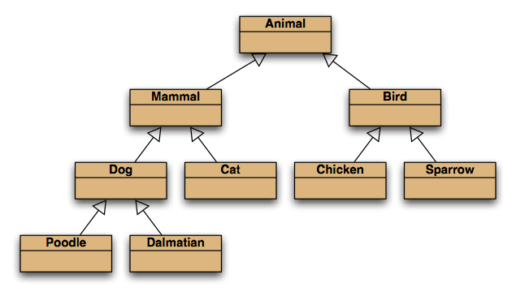
Inheritance hierarchies

Slide 15
Inheritance in Java
no change here
public class Post
{
...
}
no change here
public class PhotoPost extends Post
{
...
}
public class MessagePost extends Post
{
...
}

Slide 16
Superclass
public class Post
{
private String username;
private long timestamp;
private int likes;
private ArrayList<String> comments;
// constructor and methods omitted.
}

Slide 17
Subclasses
public class MessagePost extends Post
{
private String message;
// constructor and methods omitted.
}
public class PhotoPost extends Post
{
private String filename;
private String caption;
// constructor and methods omitted.
}

Slide 18
Inheritance and constructors
public class Post
{
private String username;
private long timestamp;
private int likes;
private ArrayList<String> comments;
/**
* Initialise the fields of the post.
*/
public Post(String author)
{
username = author;
timestamp = System.currentTimeMillis();
likes = 0;
comments = new ArrayList<>();
}
// methods omitted
}

Slide 19
Inheritance and constructors
public class MessagePost extends Post
{
private String message;
/**
* Constructor for objects of class MessagePost
*/
public MessagePost(String author, String text)
{
super(author);
message = text;
}
// methods omitted
}

Slide 20
Superclass constructor call
Subclass constructors must always contain a 'super' call.
If none is written, the compiler inserts one (without parameters)
only compiles if the superclass has a constructor without parameters
Must be the first statement in the subclass constructor.

Slide 21
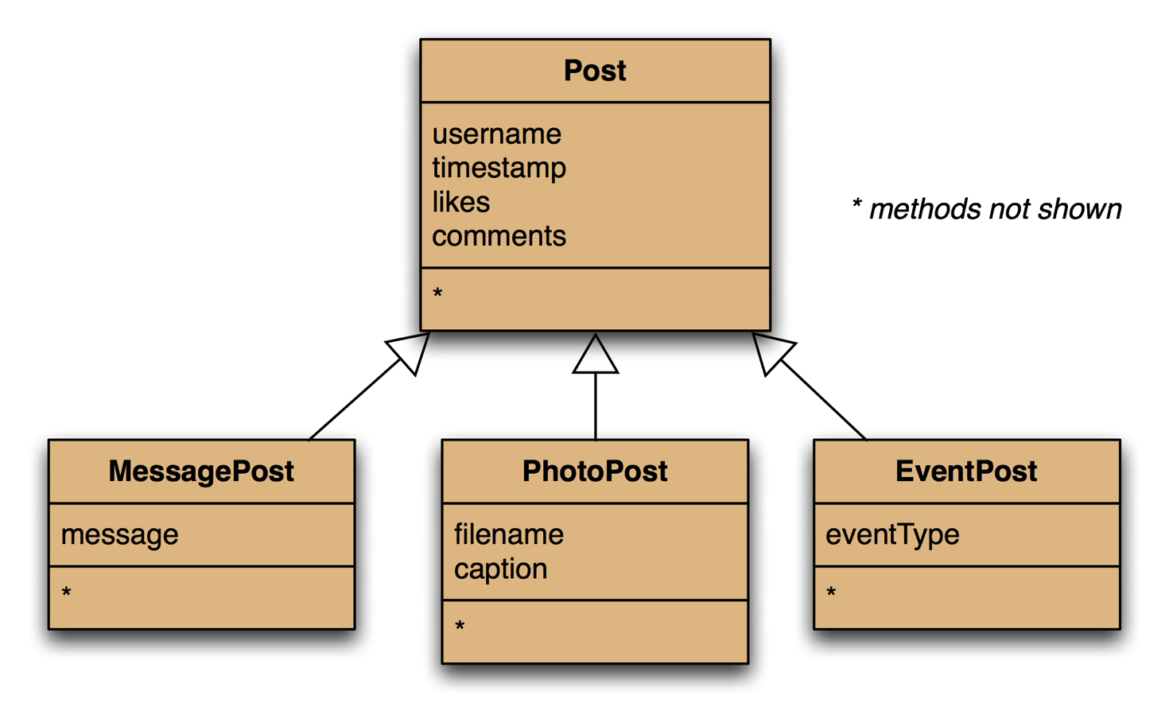
Adding more item types

Slide 22
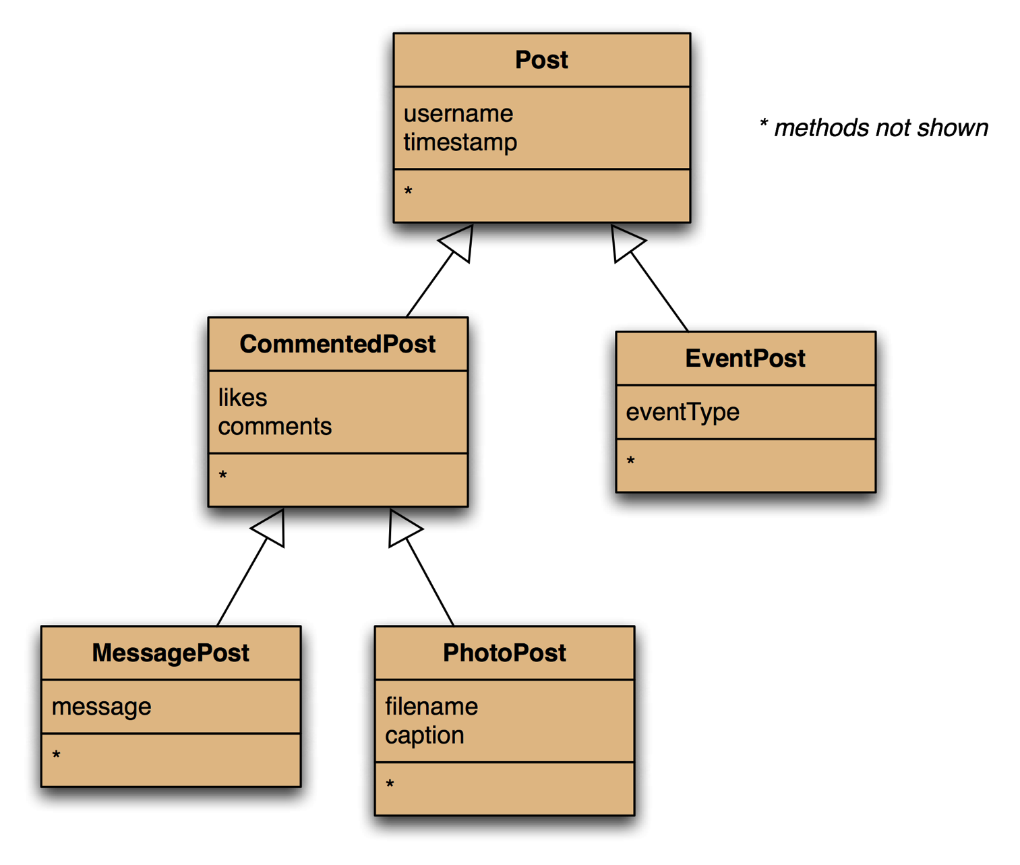
Deeper hierarchies

Slide 23
Review (so far)
Inheritance (so far) helps with:
Avoiding code duplication
Code reuse
Easier maintenance
Extendibility

Slide 24
Subclasses and subtyping
Classes define types.
Subclasses define subtypes.
Objects of subclasses can be used where objects of supertypes are required. (This is called substitution .)

Slide 25
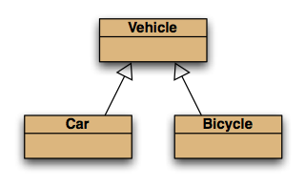
Subtyping and assignment
subclass objects may be assigned to superclass variables
Vehicle v1 = new Vehicle();
Vehicle v2 = new Car();
Vehicle v3 = new Bicycle();

Slide 26
Revised NewsFeed source code
public class NewsFeed
{
private ArrayList<Post> posts;
/**
* Construct an empty news feed.
*/
public NewsFeed()
{
posts = new ArrayList<>();
}
/**
* Add a post to the news feed.
*/
public void addPost(Post post)
{
posts.add(post);
}
...
}
Avoids code duplication in the client class!

Slide 27
New NewsFeed source code
/**
* Show the news feed. Currently: print the
* news feed details to the terminal.
* (Later: display in a web browser.)
*/
public void show()
{
for(Post post : posts) {
post.display();
System.out.println(); // Empty line ...
}
}

Slide 28
Subtyping
First, we had:
public void addMessagePost(MessagePost message)
public void addPhotoPost(PhotoPost photo)
Now, we have:
public void addPost(Post post)
We call this method with:
PhotoPost myPhoto = new PhotoPost(...);
feed.addPost(myPhoto);

Slide 29
Subtyping and parameter passing
public class NewsFeed
{
public void addPost(Post post)
{
...
}
}
PhotoPost photo = new PhotoPost(...);
MessagePost message = new MessagePost(...);
feed.addPost(photo);
feed.addPost(message);
subclass objects may be used as actual parameters for the superclass

Slide 30
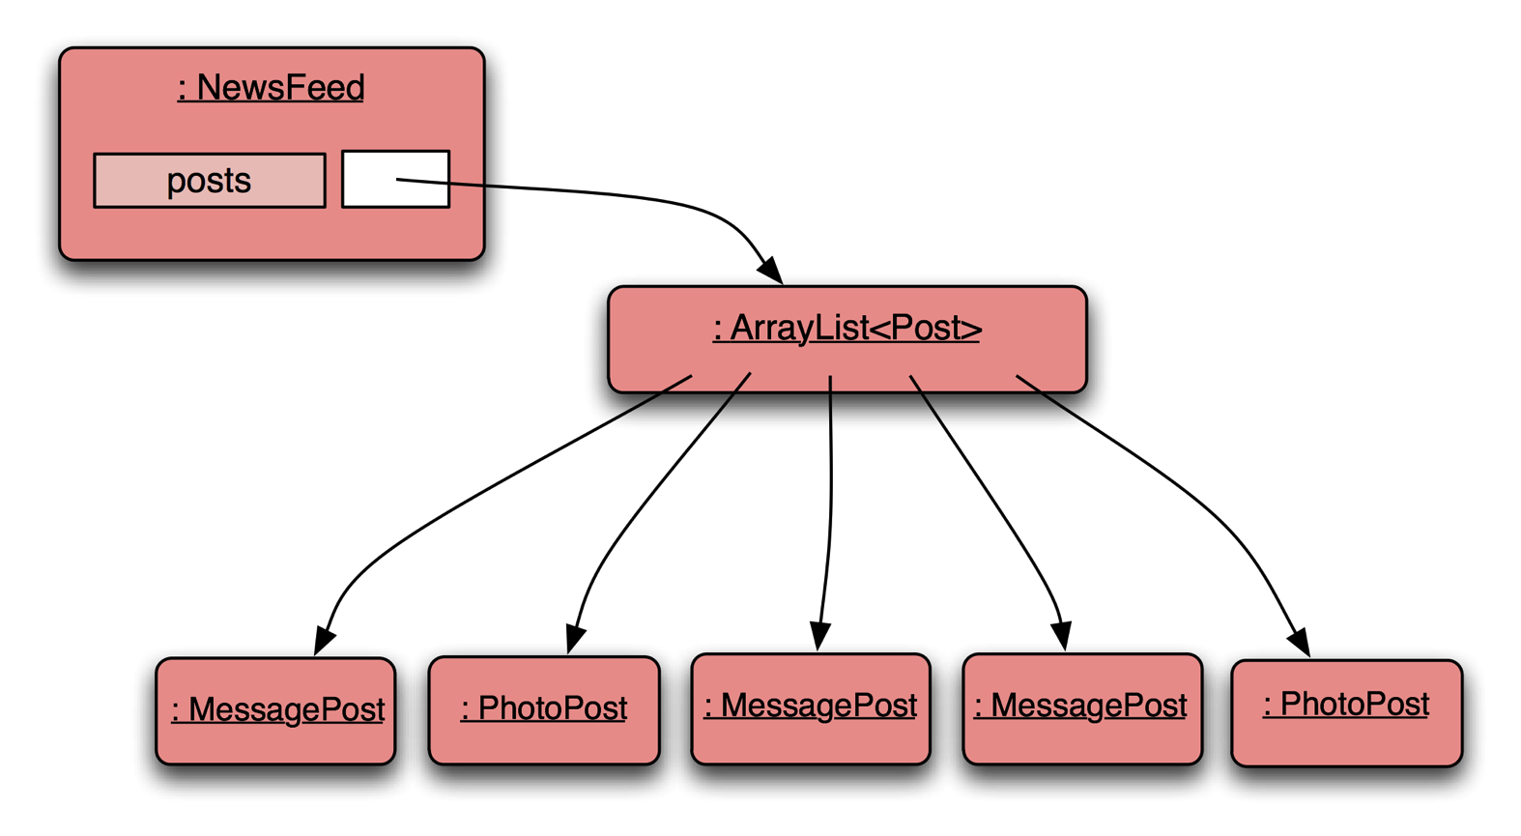
Object diagram

Slide 31
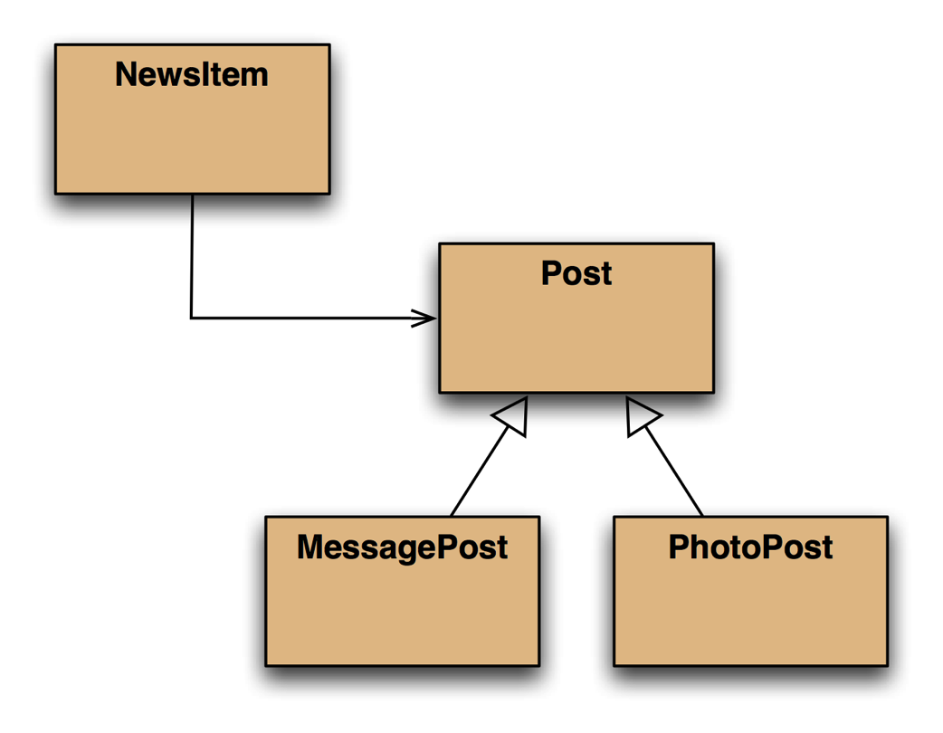
Class diagram

Slide 32
Polymorphic variables
Object variables in Java are polymorphic. (They can hold objects of more than one type.)
They can hold objects of the declared type, or of subtypes of the declared type.

Slide 33
Casting
We can assign subtype to supertype …
… but we cannot assign supertype to subtype! Vehicle v; Car c = new Car(); v = c; // correct c = v; // compile-time error!
Casting fixes this: c = (Car) v; (but only ok if the vehicle really is a Car!)

Slide 34
Casting
An object type in parentheses.
Used to overcome 'type loss'.
The object is not changed in any way.
A runtime check is made to ensure the object really is of that type:
ClassCastException if it isn't!
Use it sparingly.

Slide 35
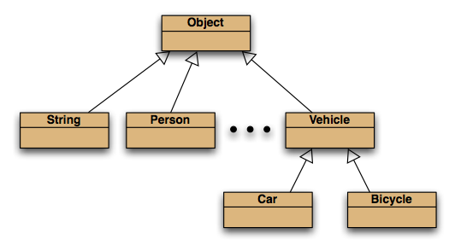
The Object class
All classes inherit from Object.

Slide 36
Polymorphic collections
All collections are polymorphic.
The elements could simply be of type Object. public void add(Object element) public Object get(int index)
Usually avoided by using a type parameter with the collection.

Slide 37
Polymorphic collections
A type parameter limits the degree of polymorphism: ArrayList<Post>
Collection methods are then typed.
Without a type parameter, ArrayList<Object> is implied.
Likely to get an “unchecked or unsafe operations” warning.
More likely to have to use casts.

Slide 38
Review
Inheritance allows the definition of classes as extensions of other classes.
Inheritance:
avoids code duplication
allows code reuse
simplifies the code
simplifies maintenance and extending
Variables can hold subtype objects.
Subtypes can be used wherever supertype objects are expected (substitution).

